Slide 1
The Impact of Early Marriage on Literacy and Education Attainment in Africa
By: Lara Baltaji

Slide 2
Big Idea
While 96% of countries have laws that identify the legal age for marriage, there are still countries that do not specify a minimum age and most are African countries. According to the UN, even some countries that do have laws grant exemptions using require courts or parental permission to let minors to wed. Early marriage not only exposes girls to sexual exploitation and violence, but it also denies their right of education and future opportunities. Therefore, countries that are suffering from low educational level of women must enforce policies that specify a minimum age for marriage (at least 18) and which allow no exemptions.

Slide 3
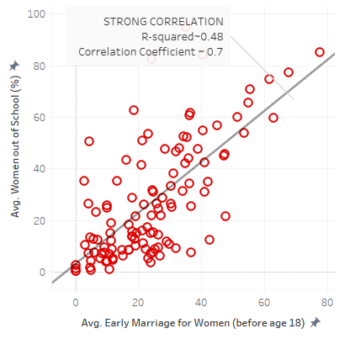
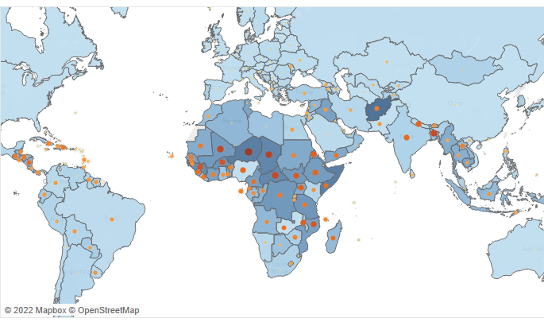
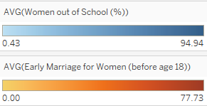
Storyboard
Problem
Problem Evidence
There are still a lot of countries with a very low education level for women and these same countries also have a very high early marriage rate for women (age below 18).
There is a strong correlation between early marriage of women and women educational level.

Slide 4
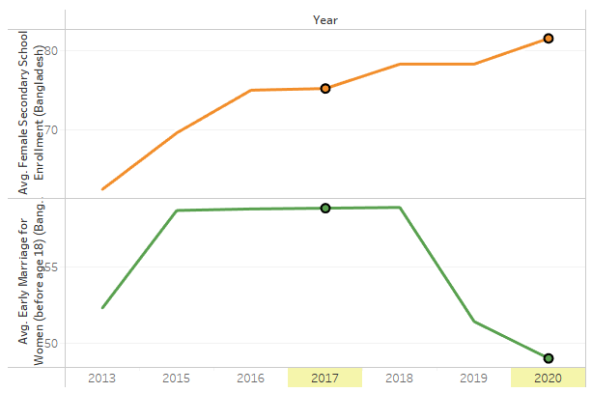
Storyboard
Solution
Solution Validation
Early marriage should stop in all countries, especially countries suffering from a low level of education for women.
Details:
The first step is to enforce laws and policies that prohibit people under a specified age (at least 18) from getting married, and which allow no exceptions.
The second step is to raise general awareness of the issue and its massive effects. This could be done by inviting women and parents with changed views and victims of early marriage to speak of the matter.
The third step is to work on reducing sexism and promoting gender equality by empowering women and integrating them in public activities and politics.
In 2017, Bangladesh followed such an approach by enforcing a Child Marriage Restraint Act that set the minimum age of marriage for women at 18 and for men at 21. This act positively influenced the overall educational level of women where the average female enrollment in secondary schools increased from 75.22% in 2017 to 81.5% in 2020.

Slide 5
Storyboard
Recommendation
African countries have long struggled with poverty and are still struggling until this very day. While policies can be set to reduce early marriage, the challenge is in decreasing poverty which is often the reason why families marry off their daughters in the first place and the reason why parents prefer rich sons-in-law to assist them financially.

Slide 6
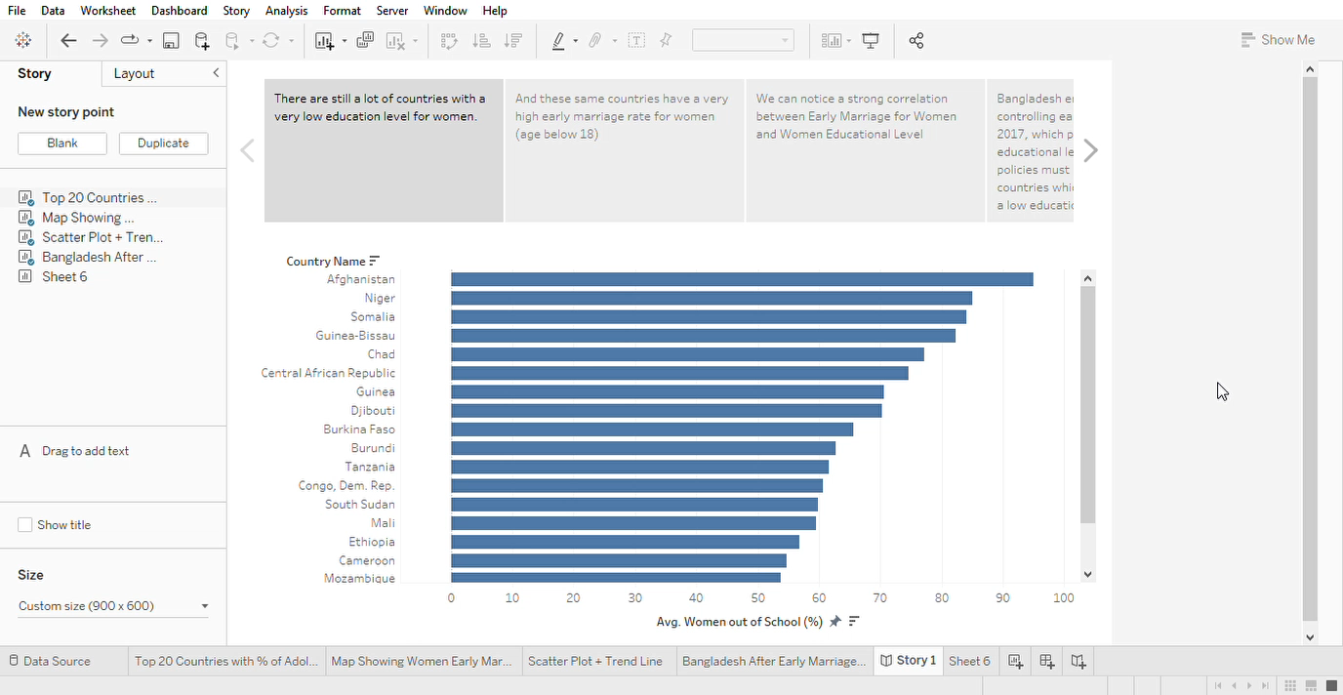
Tableau Storyboard

Slide 7
Thank You!

